Slide 1
Microsoft-Teams Apps – Advanced-Techniques
Advanced Teams Bot capabilities

Slide 2

Advanced Teams Bot capabilities _
Teams-Bot-extensions
Respond to events
Updating messages/cards
Dialogs, prompts and menus
Demo

Slide 3
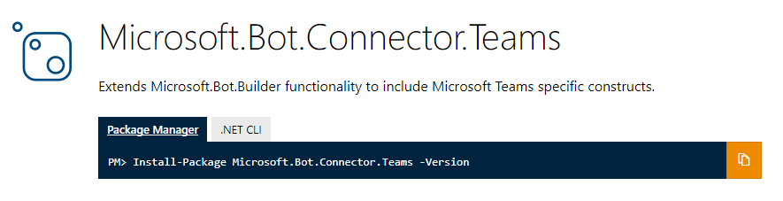
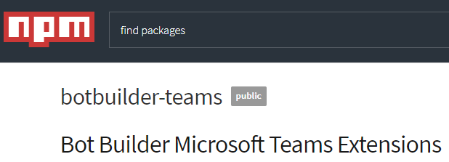
Teams-Bot-extensions
Extensions and utilities
ConnectorClient
Parse activities to system events
Parse activities to channel/member information
Extract @mentions from text
ProcessAttachments
Data models
Tenant
Team/channel
ComposeExtension
Cards
Tenant filtering
Notes:
Extension library accelerates development
Manages connection to Bot service – facilitates updats
Types to represent events
Strongly-typed data models

Slide 4
Respond to events
Reach out to users as they are added to Team
Respond to changes in Team/Channel
Type | Payload object | Teams event type | Description
conversationUpdate | membersAdded | teamMemberAdded | Bot or team member was added to team
conversationUpdate | membersRemoved | teamMemberRemoved | Bot or team member was removed from team
conversationUpdate |  | teamRenamed | Team in which bot is member was renamed
conversationUpdate |  | channelCreated | In a team where bot is member, a channel was created
conversationUpdate |  | channelRenamed | In a team where bot is member, a channel was renamed
conversationUpdate |  | chanelDeleted | In a team where bot s member, a channel was deleted
contactRelationUpdate |  |  | Not directly supported in Teams
deleteUserData |  |  | Not directly supported in Teams
Notes:
First two events are most relevant
The bot itself is a team member

Slide 5
Demo Responding to events
Notes:
Run the demo: Responding to Events

Slide 6
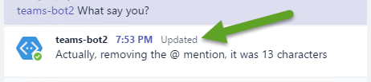
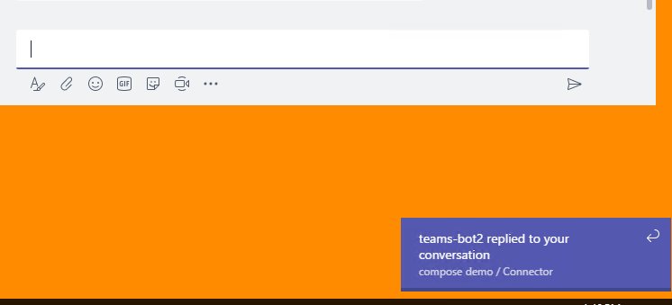
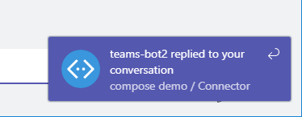
Advanced message features
Bots encourage conversation about information
Keep that information up-to-date
Update activity via SDK or REST
Updates message and attachments
Initiate 1:1 or channel conversation
Be proactive about state in your service
Alert users for important events
Don’t be noisy, be helpful
Notes:
Alerts depend on the client in use. For Windows desktop, it is a toast notification. For web, it is floating div on top of canvas

Slide 7
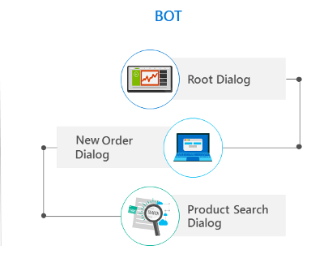
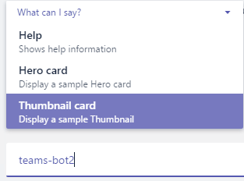
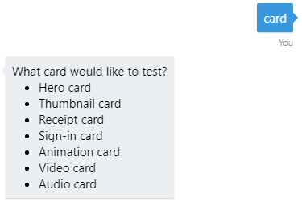
Interacting with a Bot
Dialogs
Directs conversation
Stack of dialogs – top one gets message
Scorable dialogs always respond to their commands
Prompt dialog
SDK-provided dialog
Declare choices in code
Top of stack until valid choice selected
Provide option to quite or limit number of attempts
Bot menu
Teams-specific implementation
Declare choices in manifest
Guides user, but can type anything
Keep it short & simple
Notes:
Scorable dialog registered as Global Handler in Application_Start
Prompt dialog called from other dialogs
Bot Menu is not in Bot code – only manifest & Teams client

Slide 8
Demo Advanced message features
Notes:
In a channel or chat
send the bot the message “ping” to invoke an alert.
Send message “Hero card” or “Thumbnail card” to get one back. Show picking from menu
Send any other message to have the character count returned and updated.
(works best in channel, where message has @ mention )

Slide 9

Summary

Slide 10
Thank you

